Slide 1
Contents
The course will mainly cover the following topics:
A Gentle Introduction to Machine Learning
Linear Regression
Logistic Regression
Naive Bayes
Support Vector Machines
Decision Trees and Ensemble Learning
Clustering Fundamentals
Hierarchical Clustering
Neural Networks and Deep Learning
Unsupervised Learning……
Notes:
More Supervised - Adaboost Gradient boosting Xgboost

Slide 2
Outline
A Gentle Introduction to Machine Learning
Unsupervised learning
Reinforcement learning
Linear Regression
Linear models
Hypothesis function for Linear Regression
Cost function
Gradient descent algorithm
Polynomial regression

Slide 3
Unsupervised machine learning
Unsupervised learning is a type of machine learning where the algorithm learns from unlabeled data without any predefined outputs or target variables.
It finds hidden patterns, similarities, or groupings within the data to get insights and make data-driven decisions without the need for human intervention..
It is particularly useful when dealing with large datasets where manual labeling would be impractical or costly.
This method’s ability to discover similarities and differences in information make it ideal for exploratory data analysis, cross-selling strategies, customer segmentation, and image and pattern recognition.
Cross-selling is the process of offering a customer products that are compatible with the ones they're purchasing
Notes:
Exploratory Data Analysis (EDA) examines and visualizes data to understand its main characteristics, identify patterns, spot anomalies, and test hypotheses.

Slide 4
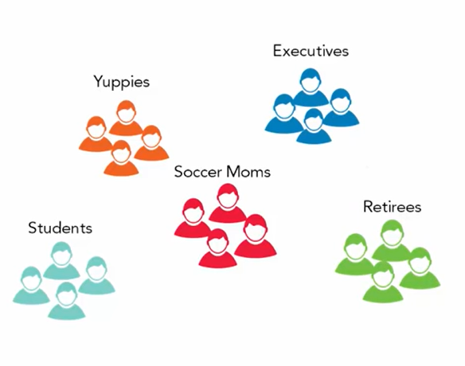
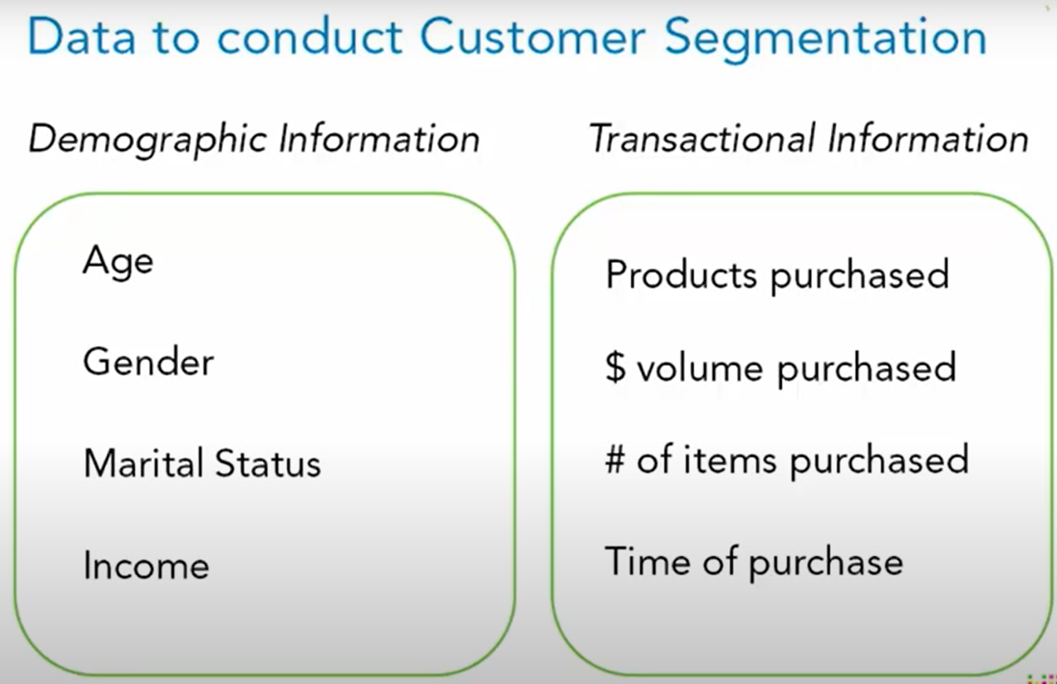
Customer segmentation is the process by which you divide your customers based on common characteristics – such as demographics or behaviours, so your marketing team or sales team can reach out to those customers more effectively.
Income
Age

Slide 5
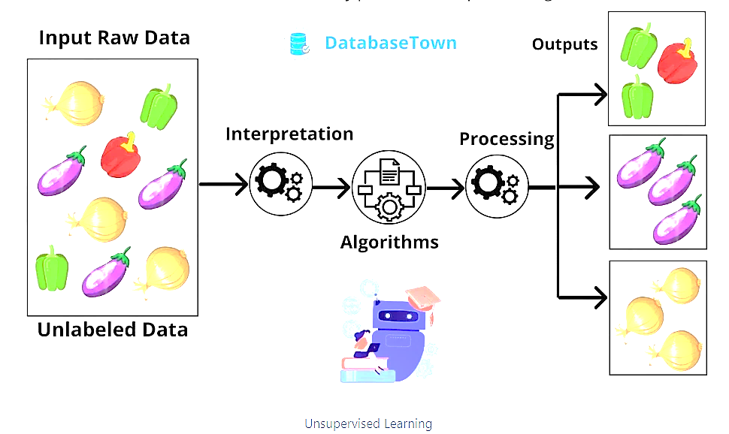
How does Unsupervised Learning Work?
Suppose an input dataset containing images of different types of cats and dogs. Here, we have taken an unlabeled input data, which means it is not categorized and corresponding outputs are not given.
Now, this unlabeled input data is fed to the machine learning model in order to train it.
Firstly, it will interpret the raw data to find the hidden patterns from the data and then will apply suitable algorithms such as K-means clustering algorithms.
Once it applies the suitable algorithm, the algorithm divides the data objects into groups according to the similarities and difference between the objects.

Slide 6
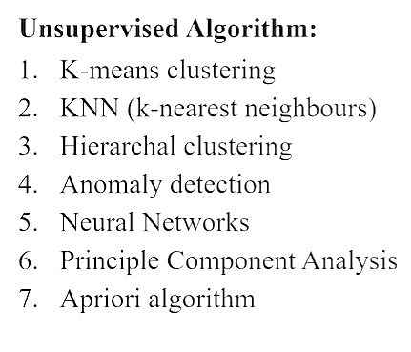
Types of Unsupervised Learning
Unsupervised learning can be broken down into three main tasks:
Clustering
Association rules
Dimensionality reduction.

Slide 7
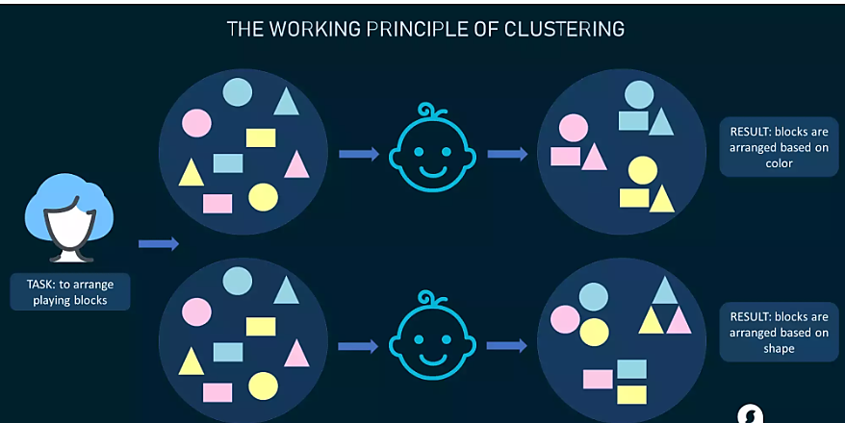
Types of Unsupervised Learning
Clustering Algorithms
Clustering algorithms only interpret the input data and find natural groups or clusters in feature space
Clustering is a popular type of unsupervised learning approach. You can even break it down further into different types of clustering; for example:
Exlcusive clustering: or “hard” clustering
It is the kind of grouping in which one piece of data can belong only to one cluster.
Overlapping clustering:
A soft cluster in which a single data point may belong to multiple clusters with varying degrees of membership.

Slide 8
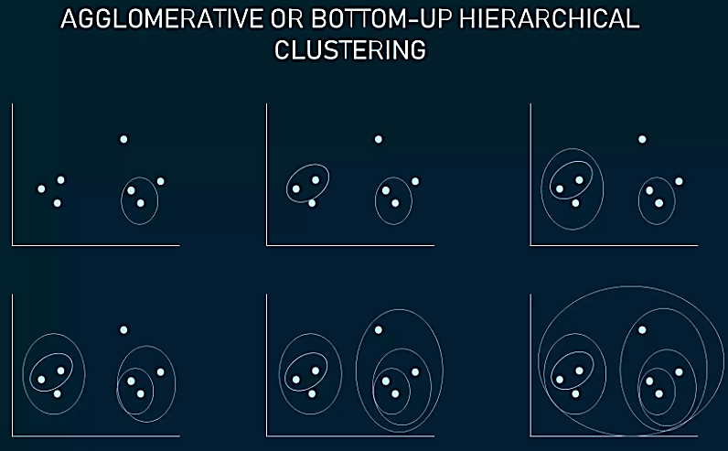
Types of Unsupervised Learning
Clustering Algorithms
Hierarchical Clustering:
Hierarchical clustering develops a hierarchy of clusters by merging or splitting them depending on their similarity. Here, two close cluster are going to be in the same cluster.
In case you start with all data items attached to the same cluster and then perform splits until each data item is set as a separate cluster, the approach will be called top-down or divisive hierarchical clustering.
Two clusters that are closest to one another are then merged into a single cluster. The merging goes on iteratively till there's only one cluster left at the top. Such an approach is known as bottom-up or agglomerative.
The example shows how seven different clusters (data points) are merged step by step based on distance until they all create one large cluster.

Slide 9
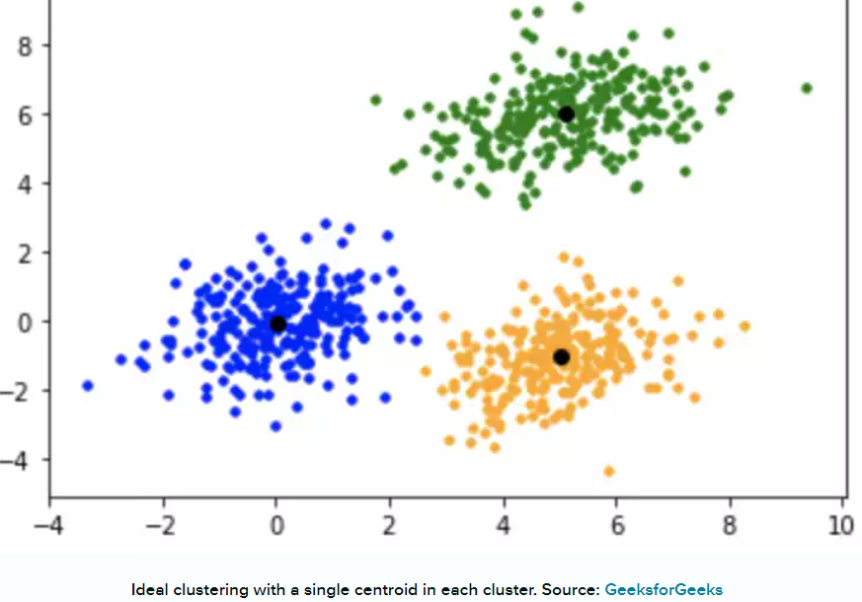
Types of Unsupervised Learning
Clustering Algorithms
K-Means Clustering
In K-means clustering, data is grouped in terms of characteristics and similarities.
K is a letter that represents the number of clusters. For example, if K=3, then the number of desired clusters is 3. If K=10, then the number of desired clusters is 10.
It puts the data points into the predefined number of clusters K.
Each data item then gets assigned to the nearest cluster center, called centroids (black dots in the picture). The latter act as data accumulation areas.
The procedure of clustering may be repeated several times until the clusters are well-defined.
Notes:
In this algorithm, data is divided into a specific number of groups or clusters. It is achieved by minimizing the total squared distances between the data points and the centers of each cluster.

Slide 10
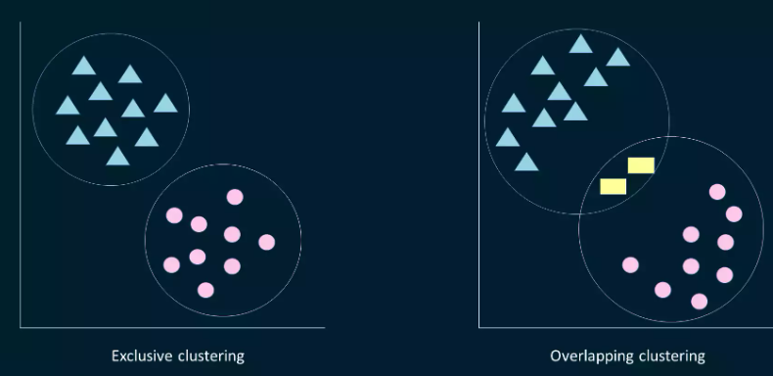
Types of Unsupervised Learning
Clustering Algorithms
Fuzzy K-means
It is an extension of the K-means algorithm used to perform overlapping clustering. Unlike the K-means algorithm, fuzzy K-means implies that data points can belong to more than one cluster with a certain level of closeness towards each.
The closeness is measured by the distance from a data point to the centroid of the cluster. So, sometimes there may be an overlap between different clusters.

Slide 11
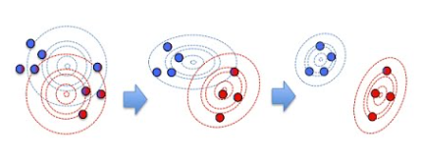
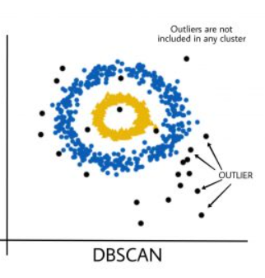
Types of Unsupervised Learning
Clustering Algorithms
Gaussian Mixture Models (GMMs) is an algorithm used in probabilistic clustering.
Models assume that there is a certain number of Gaussian distributions, each representing a separate cluster.
The algorithm is basically utilized to decide which cluster a particular data point belongs to.
DBSCAN (Density-Based Spatial Clustering of Applications with Noise): DBSCAN groups data points based on their density, identifying clusters of high-density regions and classifying outliers as noise.

Slide 12
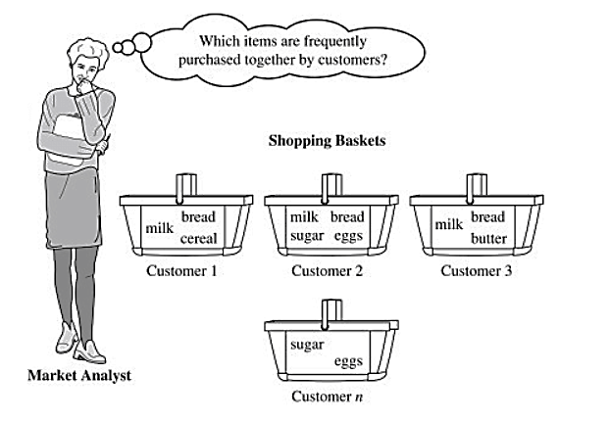
Types of Unsupervised Learning
Association Rule Mining
Association rule mining focuses on discovering interesting relationships or patterns between variables in the large database. It determines the set of items that occurs together in the dataset. Association rule makes marketing strategy more effective. Such as people who buy X (suppose a bread) also tend purchase Y (Butter/Jam) item. The widely used algorithm for association rule mining is the Apriori algorithm.
A real-life example of this is market basket analysis, where retailers analyze customer purchase data to identify relationships between products frequently bought together. For instance, this analysis might reveal that customers who purchase diapers also tend to buy baby wipes

Slide 13
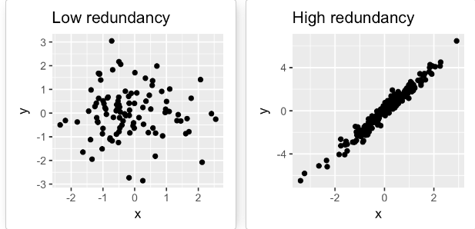
Types of Unsupervised Learning
Dimensionality Reduction Algorithms Dimensionality reduction techniques are used to reduce the number of input variables or features while retaining meaningful information. Some popular dimensionality reduction algorithms include:
Principal Component Analysis (PCA): PCA transforms the original features into a lower-dimensional space while preserving the maximum amount of information.
The PCA method is particularly useful when the variables within the data set are highly correlated. Correlation indicates that there is redundancy in the data. Due to this redundancy, PCA can be used to reduce the original variables into a smaller number of new variables ( principal components) explaining most of the variance in the original variables.

Slide 14
What is the difference between supervised and unsupervised learning?
Supervised learning requires labeled data with input features and corresponding output labels, while unsupervised learning aims to discover patterns or structures in unlabeled data without predefined output labels.

Slide 15
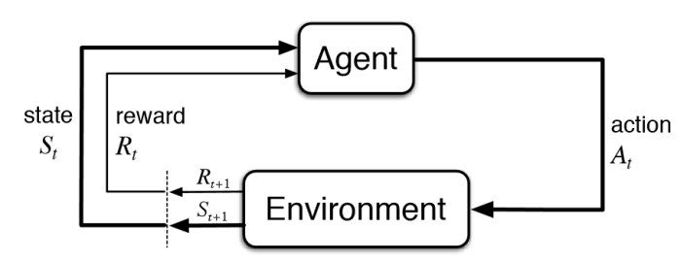
Reinforcement machine learning
Reinforcement Learning(RL) enables an agent to learn in an interactive environment by trial and error using feedback from its own actions and experiences.
Here, agents are self-trained on reward and punishment mechanisms.
It can take actions and interact with it.
Reinforcement machine learning algorithm isn’t trained using sample data.
A sequence of successful outcomes will be reinforced to develop the best recommendation or policy for a given problem.
Basic Diagram of Reinforcement Learning
Notes:
This model learns as it goes by using trial and error.

Slide 16
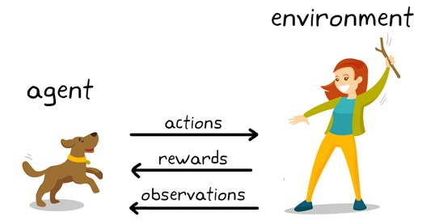
Reinforcement machine learning
Through a series of Trial and Error methods, an agent keeps learning continuously in an interactive environment from its own actions and experiences.
The only goal of it is to find a suitable action model which would increase the total cumulative reward of the agent.
It learns via interaction and feedback.
You can see a dog and a master. Let’s imagine you are training your dog to get the stick. Each time the dog gets a stick successfully, you offered him a feast (a bone ).
Eventually, the dog understands the pattern, that whenever the master throws a stick, it should get it as early as it can gain a reward (a bone) from a master in a lesser time.
Reinforcement Learning Example

Slide 17
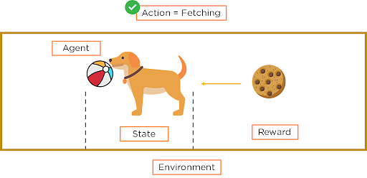
Important Terms in Reinforcement Learning
Agent: Agent is the model that is being trained via reinforcement learning. It is the sole decision-maker and learner
Environment: a physical world where an agent learns and decides the actions to be performed
Action: All possible steps that can be taken by the model/agent
State: The current position/ condition returned by the model/the current situation of the agent in the environment
Reward: To help the model move in the right direction, it is rewarded/points are given to it to appraise some action. It’s usually a scalar value and nothing but feedback from the environment
Policy: Policy determines how an agent will behave at any time. It acts as a mapping between Action and present State. The agent prepares strategy(decision-making) to map situations to actions.
Value — Future reward that an agent would receive by taking an action in a particular state

Slide 18
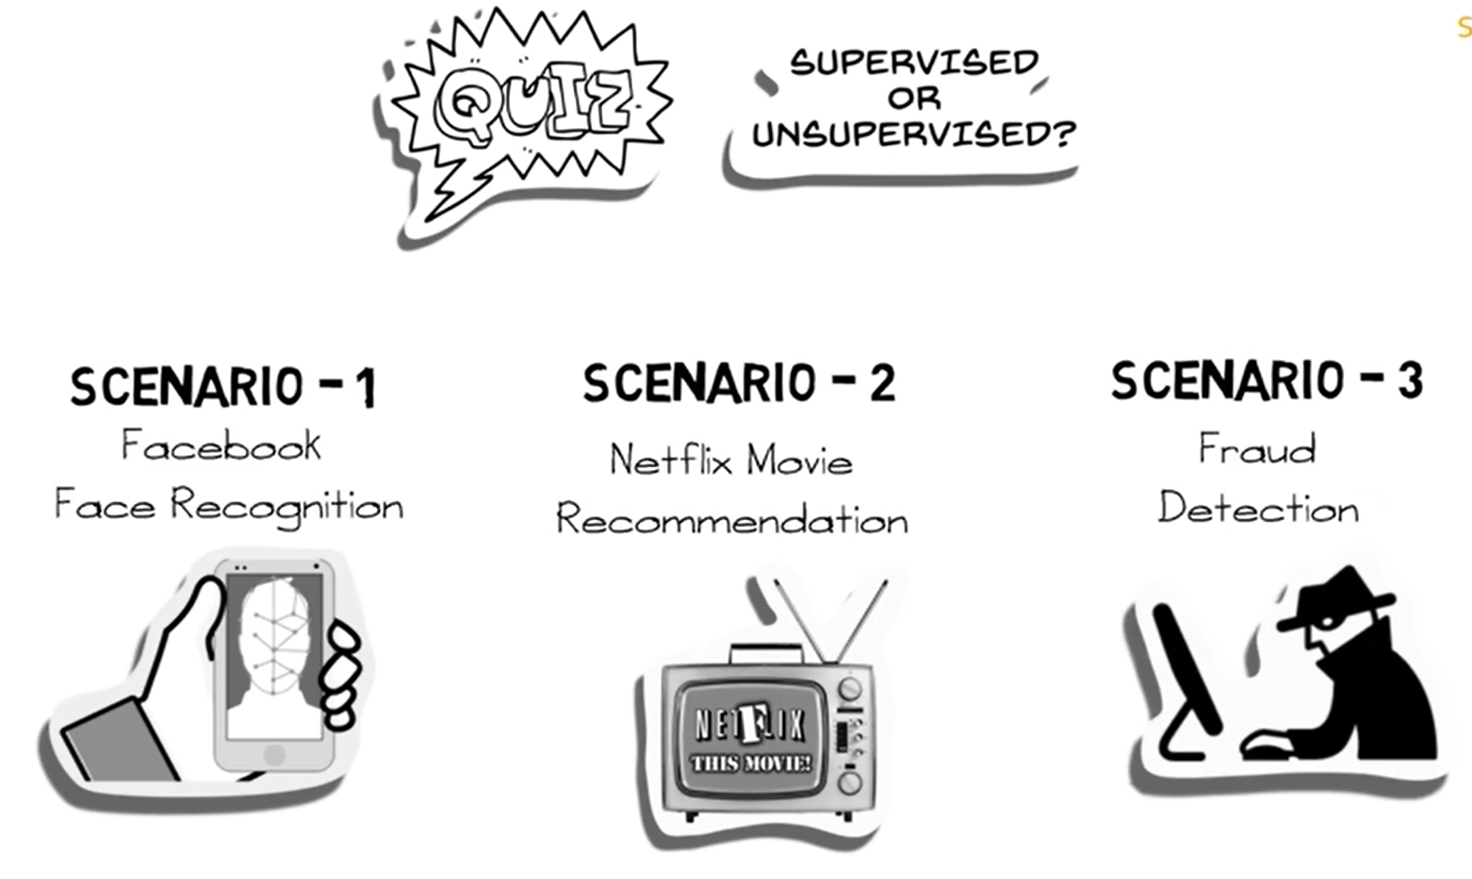

Slide 19
Explanation
Scenario 1: Facebook recognizes your friend in a picture from an album of tagged photographs
Explanation: It is supervised learning. Here Facebook is using tagged photos to recognize the person. Therefore, the tagged photos become the labels of the pictures and we know that when the machine is learning from labeled data, it is supervised learning.
Scenario 2: Recommending new songs based on someone’s past music choices
Explanation: It is supervised learning. The model is training a classifier on pre-existing labels (genres of songs). This is what Netflix, Pandora, and Spotify do all the time, they collect the songs/movies that you like already, evaluate the features based on your likes/dislikes and then recommend new movies/songs based on similar features.
Scenario 3: Analyze bank data for suspicious looking transactions and flag the fraud transactions
Explanation: It is unsupervised learning. In this case, the suspicious transactions are not defined, hence there are no labels of "fraud" and "not fraud". The model tries to identify outliers by looking at anomalous transactions and flags them as 'fraud'.

Slide 20
Outline
Linear Regression
Linear models
Hypothesis function for Linear Regression
Cost function

Slide 21
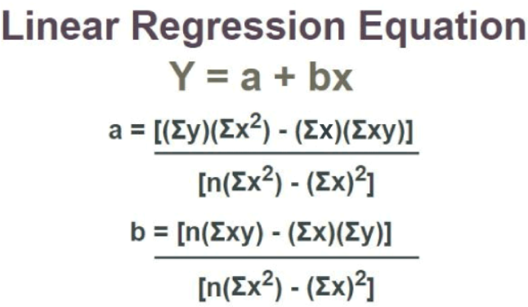
Linear Regression
Linear regression is a statistical method that is used in various machine learning models to predict the value of unknown data using other related data values. Linear regression is used to study the relationship between a dependent variable and an independent variable.

Slide 22
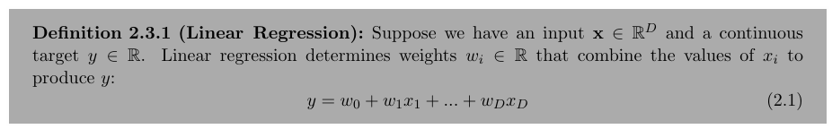
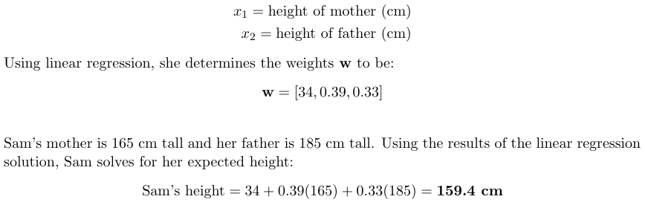
Let’s illustrate how linear regression works using an example, considering the case of 10 year old Sam. She is curious about how tall she will be when she grows up. She has a data set of parents’ heights and the final heights of their children. The inputs x are

Slide 23
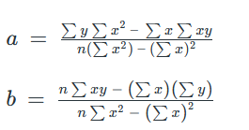
Linear Regression Equation
Linear regression line equation is written in the form:
y = a + bx
where,
→ x is Independent Variable, Plotted along X-axis
→ y is Dependent Variable, Plotted along Y-axis
The slope of the regression line is “b”, and the intercept value of regression line is “a”(the value of y when x = 0).
Linear Regression Formula
Formula used for linear regressions is, y = a + bx
Intercept value, a, and slope of the line, b, are evaluated using the formulas given below:
where,
y is Dependent Variable that Lies along Y-axis
a is Y-Intercept
b is Slope of regression line
x is Independent Variable that Lies along X-axis

Slide 24
Properties of Linear Regression
In the linear regression line if the regression parameters a₀ and a₁ are defined, the properties are given as below:
Linear regression line reduces the sum of squared differences between
observed values and predicted values.
Linear regression line always passes through the mean of X and Y variable
values.
Linear regression constant (b₀) is equal to the y-intercept of the linear
regression.
→ Linear regression coefficient (b₀) is the slope of the regression line.

Slide 25

What is Linear Regression Used for?
Various uses of Linear Regression are:
→ It is used in market research and
study of customer survey results.
→ It is used for studying
performance of engine of
automobiles.
→ It is used in deciding the effective
price of any goods.
→ It is used in astronomy.
Regression Coefficient
Linear regression line, equation:
Y = B₀ + B₁X
where,
B₀ is a Constant
B₁ is Regression Coefficient
Here, B₁ is the regression coefficient and its formula is,
where,
→ x_{i} and y_{i} are Observed Data Sets
→ x and y are Mean Value

Slide 26
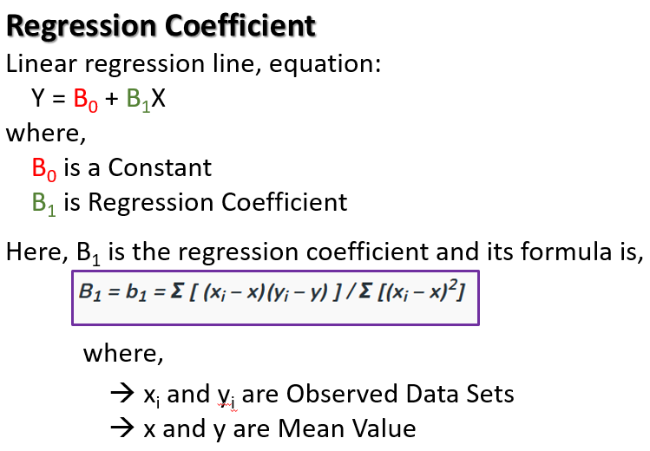
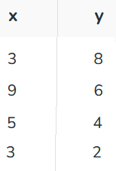
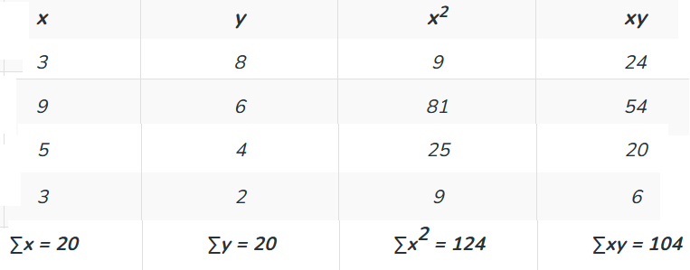
Question 1: Find the linear regression equation for the given data:
Calculating intercept and slope value.

Slide 27


Using formula for a,
a = {20 (124) – 20 (104)} / {4 (124) – 400}
a = 400/96 = 4.17
Using formula for b,
b = {4 (104) – 20 (20)} / {4 (124) – 400}
b = 16/96 = 0.166
So, linear regression equation is:
y=a+bx => y = 4.17 + 0.166x

Slide 28
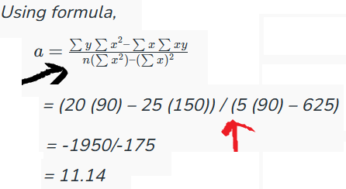
Find the intercept of linear regression line if ∑x = 25, ∑y = 20, ∑x² = 90, ∑xy = 150 and n = 5.
SLOPE??

Slide 29
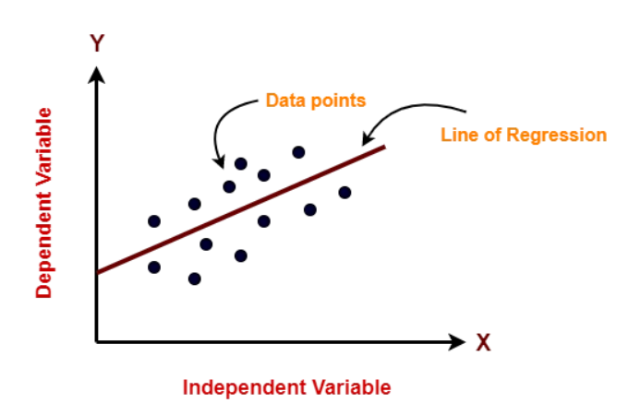
11/11/2024
The equation for a simple linear regression model can be written as follows:
y = b₀ + b₁ * x
Here, y is the dependent variable (the variable we are trying to predict), x is the independent variable (the predictor or feature).
b0 is the intercept term (the value of y when x is zero), and
b1 is the slope coefficient (the change in y for a unit change in x).
The goal of Linear Regression is to find the best values for b0 and b1 such that the line best fits the data points, minimizing the errors or the difference between the predicted values and the actual values.

Slide 30
Types of Linear Regression?
There are two main types of Linear Regression models:
-- Simple Linear Regression and
-- Multiple Linear Regression.
Simple Linear Regression: In simple linear regression, there is only one independent variable (also known as the predictor or feature) and one dependent variable (also known as the response variable). The goal of simple linear regression is to find the best-fitting line to describe the relationship between the independent and dependent variable. The equation for a simple linear regression model can be written as:
Y = b₀ + b₁ * X
Here, Y is the dependent variable, X is the independent variable, b0 is the intercept term, and b1 is the slope coefficient.

Slide 31
Multiple Linear Regression: In multiple linear regression, there are multiple independent variables and one dependent variable. The goal of multiple linear regression is to find the best-fitting line to describe the relationship between the independent variables and the dependent variable. The equation for a multiple linear regression model can be written as:
Y = b₀ + b₁ * X₁ + b₂ * X₂ + … + b_{n} * X_{n}
Here, Y is the dependent variable, X1, X2, …,
Xn are the independent variables,
b0 is the intercept term, and
b1, b2, …, bn are the slope coefficients.

Slide 32
In both types of linear regression, the goal is to find the best values for the intercept and slope coefficients that minimize the difference between the predicted values and the actual values.

Slide 33
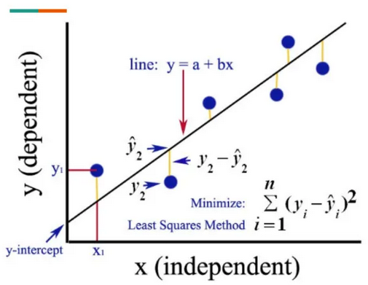
Finding the best fit line
In machine learning, finding the best-fitting line is crucial in linear regression, as it determines the accuracy of the predictions made by the model. The best-fitting line is the line that has the smallest difference between the predicted values and the actual values.
To find the best-fitting line in a linear regression model, one uses a process called “ordinary least squares (OLS) regression”.
This process involves calculating the sum of the squared differences between the predicted values and the actual values for each data point, and then finding the line that minimizes this sum of squared errors.

Slide 34
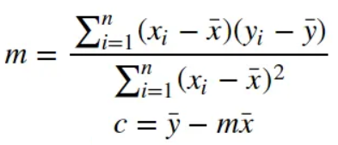
The best-fitting line is found by minimizing the residual sum of squares (RSS), which is the sum of the squared differences between the predicted values and the actual values.
This is achieved by adjusting the values of the intercept and slope coefficients, also known as c and m, respectively.
Once the values of c and m are determined, we can use the linear regression equation to make predictions for new data points. The equation for a simple linear regression model can be written as:
y = c + m * x
Here, y is the dependent variable (the variable we are trying to predict), x is the independent variable (the predictor or feature), c is the intercept term (the value of y when x is zero), and m is the slope coefficient (the change in y for a unit change in x).

Slide 35

Cost function
The cost function, also known as the loss function or objective function, is a measure of how well the model is performing. In linear regression, the cost function is used to calculate the difference between the predicted values and the actual values, also known as the residuals or errors.
The goal of linear regression is to minimize the cost function, which is achieved by finding the best-fitting line that minimizes the sum of the squared differences between the predicted values and the actual values. The most commonly used cost function in linear regression is the Mean Squared Error (MSE), which is calculated as the average of the squared differences between the predicted and actual values:
* Here, n is the number of data points, y_{i} is the actual value, and ŷ_{i} is the predicted value.

Slide 36
Model Performance
Model performance in linear regression can be evaluated using various metrics that measure how well the model fits the data and how well it generalizes to new data. Go to next slides for common metrics used in linear regression: ………………………………

Slide 37
Example:
Let, there is a linear regression model that predicts housing prices based on the size of the house. Here, 10 data points with the following actual prices (y) and predicted prices (y_hat):
y = [100, 150, 200, 250, 300, 350, 400, 450, 500, 550]
y_hat = [110, 140, 180, 240, 290, 320, 380, 420, 480, 520]
* y_mean = sum(y) / len(y) = 325
Sum of Squares Regression (SSR):
SSR is calculated by taking the sum of the squared differences between the predicted values and the mean of the dependent variable. It represents the variability in the dependent variable that is explained by the independent variables. Mathematically, it can be expressed as:
SSR = sum((y_hat — y_mean)²) = 28300

Slide 38
2. Sum of Squares Error (SSE):
SSE is calculated by taking the sum of the squared differences between the predicted values and the actual values of the dependent variable. Mathematically, it can be expressed as:
SSE = sum((y — y_hat)²) = 26700
3. Mean Squared Error (MSE):
This metric measures the average squared difference between the predicted and actual values. It is calculated as the sum of squared residuals divided by the number of data points. A lower MSE indicates better performance. Mathematically, it can be expressed as:
MSE = (1/n) * sum((y — y_hat)²) = 2670

Slide 39
4. Root Mean Squared Error (RMSE):
This metric measures the square root of the MSE and is useful for interpreting the errors in the same units as the dependent variable. Mathematically, it can be expressed as:
RMSE = sqrt(MSE) = sqrt(2670) = 51.68
5. Mean Absolute Error (MAE):
This metric measures the average absolute difference between the predicted and actual values. It is less sensitive to outliers than MSE, but still provides a measure of the model’s accuracy. Mathematically, it can be expressed as:
MAE = (1/n) * sum(abs(y — y_hat)) = 36
6. Sum Of Squares Total (SST):
SST is calculated by taking the sum of the squared differences between the actual values of the dependent variable and its mean value. Mathematically, it can be expressed as:
SST = sum((y — y_mean)²) = 55000

Slide 40
R-Squared (R²):
This metric measures the proportion of variance in the dependent variable that is explained by the independent variable(s).
It ranges from 0 to 1, with a higher value indicating better performance.
R² = SSR / SST = 28300 / 55000 = 0.5164
R² = 1 — SSE / SST = 1 —26700 / 55000 = 0.5164

Slide 41
Outline
Linear Regression
Gradient descent algorithm
Polynomial regression

Slide 42
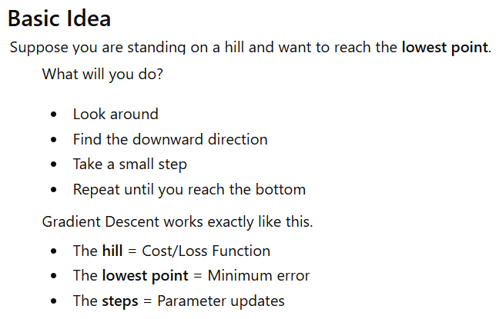
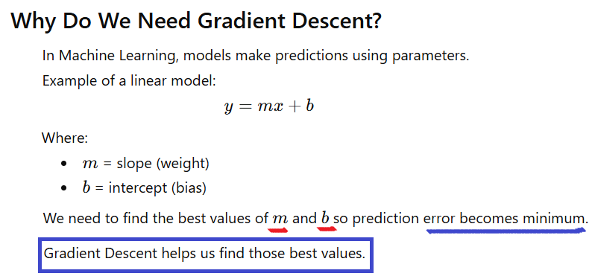
Gradient descent algorithm

Slide 43
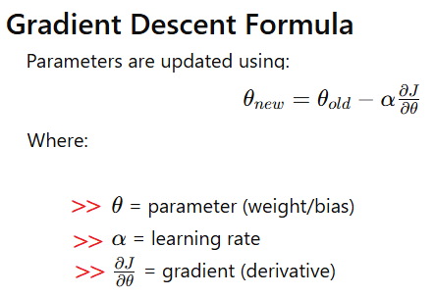
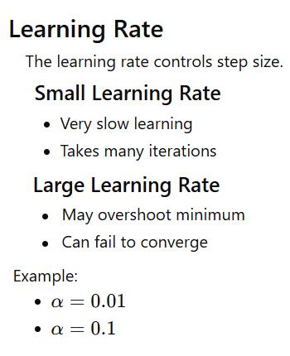

Slide 44
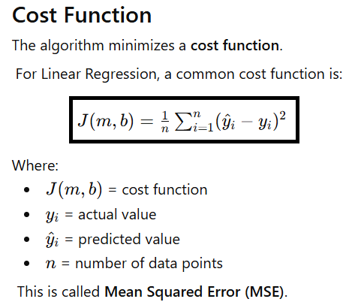
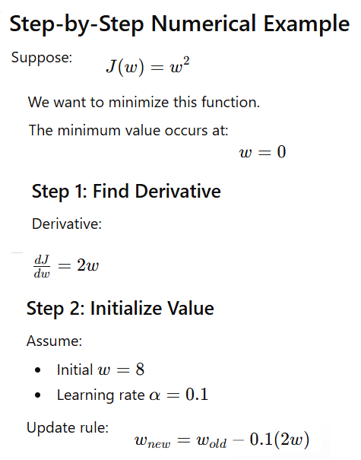
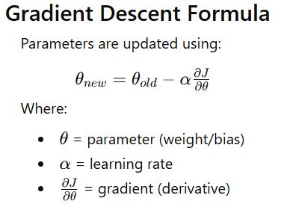
1
3
2

Slide 45

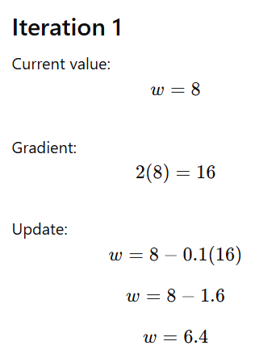
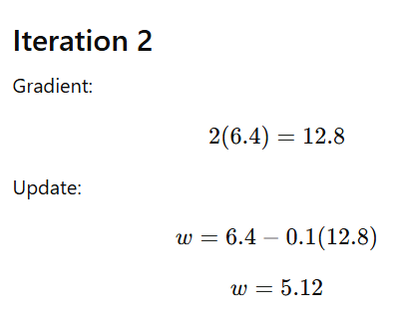
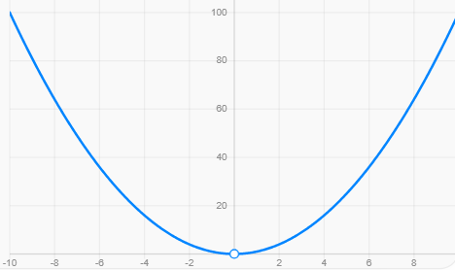
5
4

Slide 46
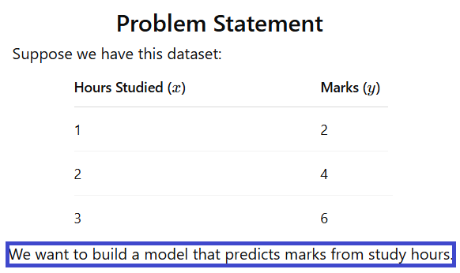
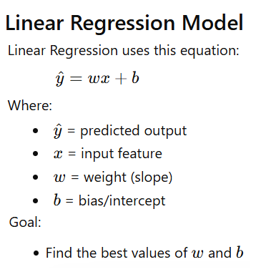
Application of Gradient Descent in Linear Regression

Slide 47
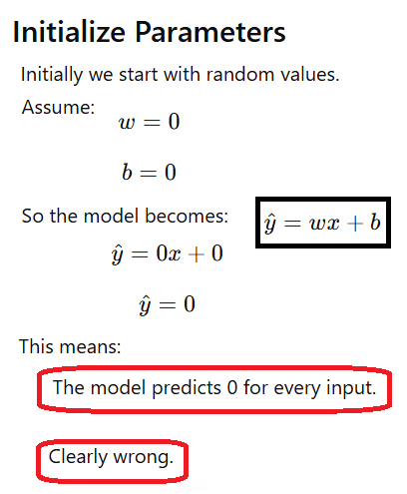
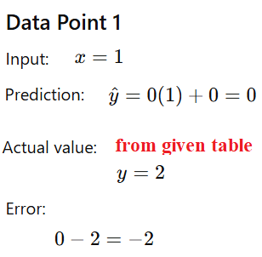
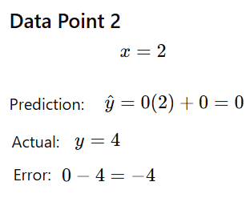
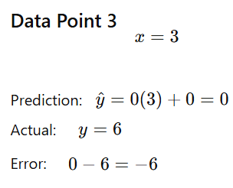

Slide 48
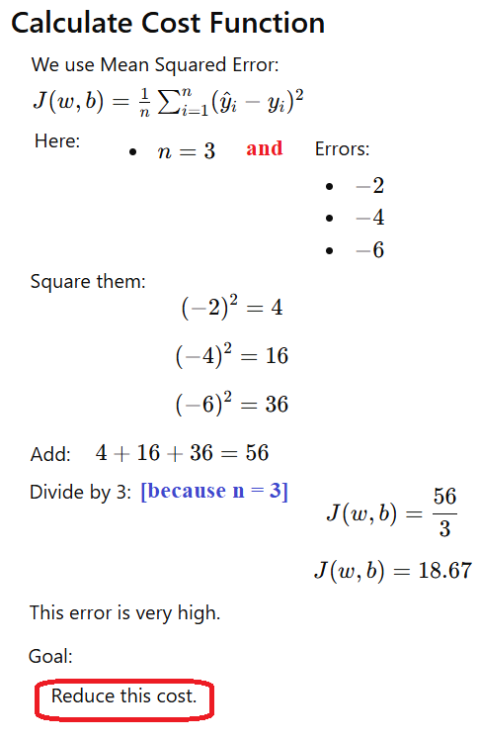
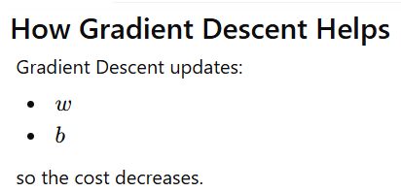
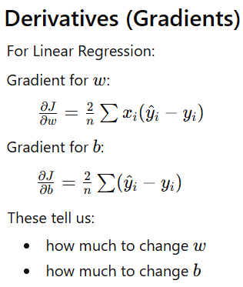

Slide 49
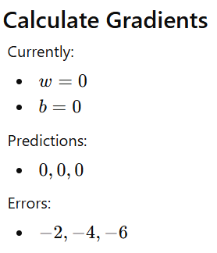
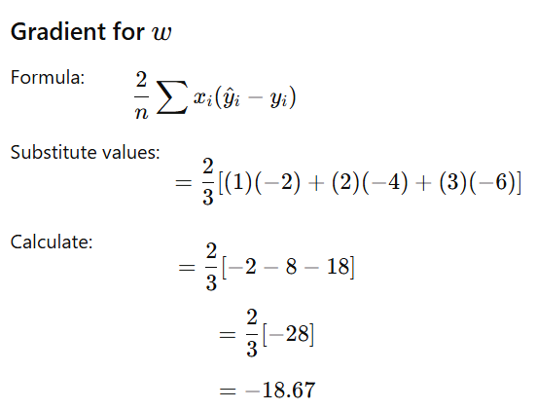
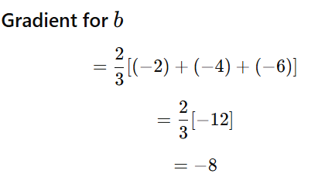

Slide 50
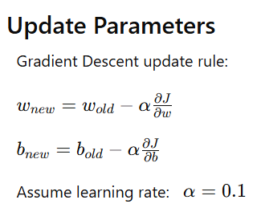







Slide 51



Slide 52
# Training
for i in range(5):
y_pred = w*x + b
error = y_pred - y
dw = (2/len(x)) * np.sum(x * error)
db = (2/len(x)) * np.sum(error)
w = w - alpha * dw
b = b - alpha * db
cost = np.mean(error**2)
print("Iteration:", i+1)
print("w =", w)
print("b =", b)
print("cost =", cost)
print()
import numpy as np
# Dataset
x = np.array([1,2,3])
y = np.array([2,4,6])
# Initial values
w = 0
b = 0
# Learning rate
alpha = 0.1

Slide 53




Slide 54


How To Choose Learning Rate
The choice of correct learning rate is very important as it ensures that Gradient Descent converges in a reasonable time.
If we choose α to be very large, Gradient Descent can overshoot the minimum. It may fail to converge or even diverge.
If we choose α to be very small, Gradient Descent will take small steps to reach local minima and will take a longer time to reach minima.

Slide 55


Example in a Real-World Scenario
Consider a machine learning model where you’re trying to minimize the error between predicted and actual values (the loss function). The parameters could be the weights in a linear regression model predicting house prices. The gradient descent algorithm would iteratively adjust these weights to minimize the difference (loss) between the predicted and actual house prices.

Slide 56


Slide 57


Slide 58




Slide 59




Slide 60



Slide 61




Slide 62



Slide 63


Slide 64


Slide 65



Slide 66




Slide 67



Slide 68



Slide 69



Slide 70


Slide 71
Thank You

